Slide 1

Meeting 6-4-2022
Rosa Maessen

Slide 2
Project Proposal
Research Question
Research question:
Can skill mutation result from doing robot-to-robot learning, and if so, how does the skill mutate and what causes it?
Sub-questions:
Does the skill of a robot mutate during robot-to-robot learning, and if so, how does it mutate?
What conditions cause the mutation of the robots’ skills?
Is skill mutation repeatable when using the same conditions?

Slide 3
Hypotheses
The skill will mutate during robot-to-robot learning.
Reasoning: Paper [4] and python simulation
The skill mutation will, during the first robot-to-robot process, be relatively large, but when going further in the robot-to-robot learning process it will still be there but less significantly.
Reasoning: Simple python simulation
Every changed condition will influence the mutation of the skill.
Reasoning: Python simulation (+ maybe add additional reasoning based on either logical or paper)
The skill mutation is not repeatable.
Reasoning: if all conditions are fixed it should be repeatable, but as it is assumed that a change in condition will influence the behavior, and it is almost impossible to fix all conditions in the real world (there is always variability), the mutation is assumed to not be repeatable.

Slide 4
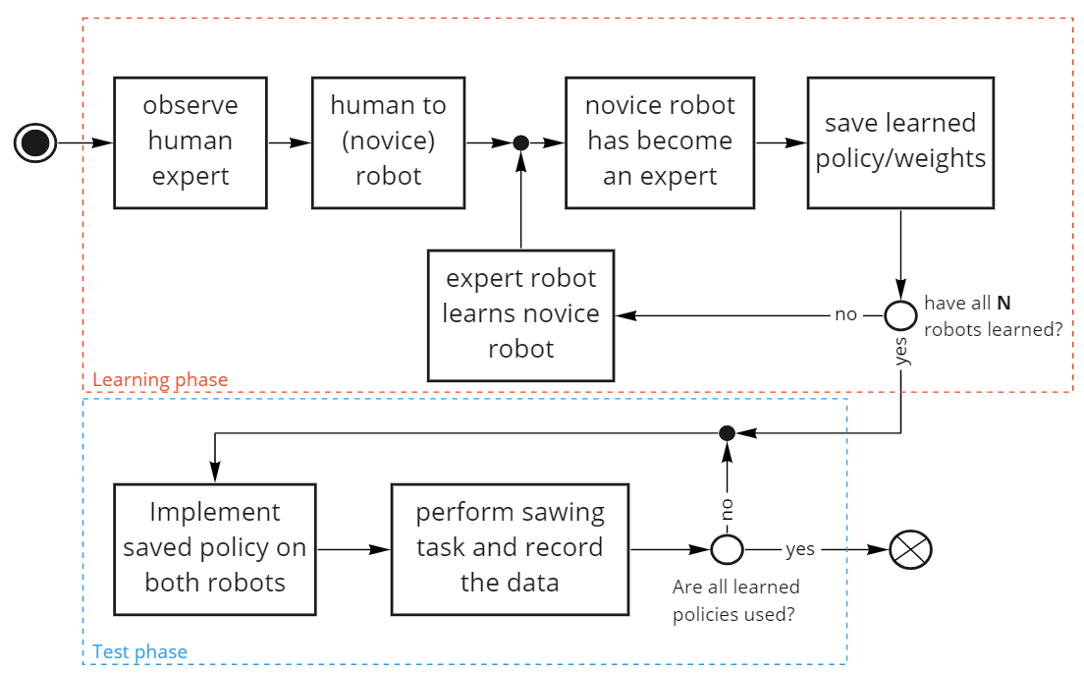
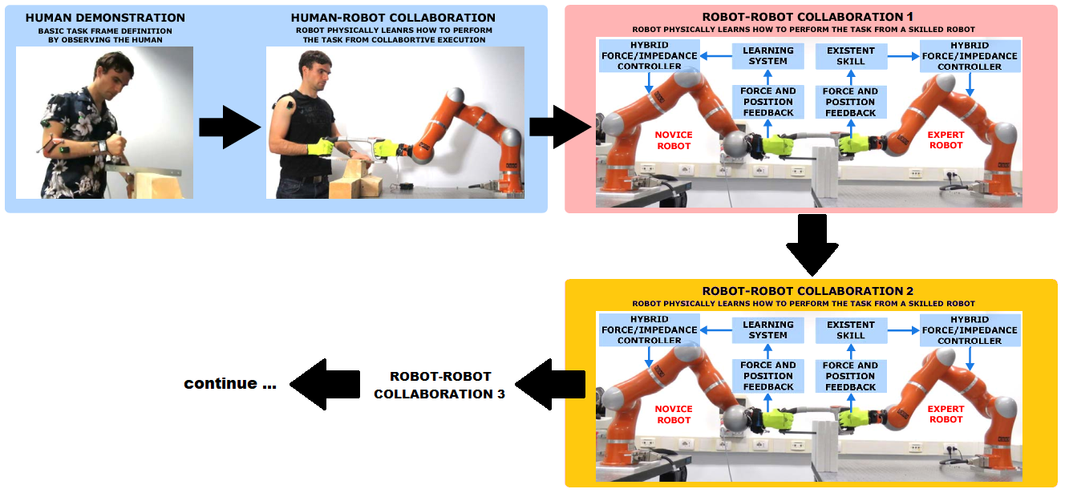
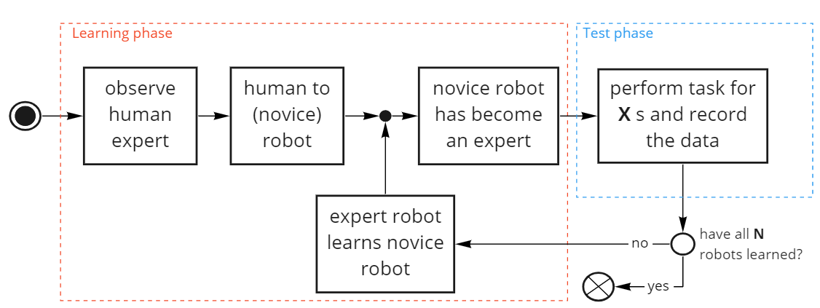
Experiment 1

Slide 5
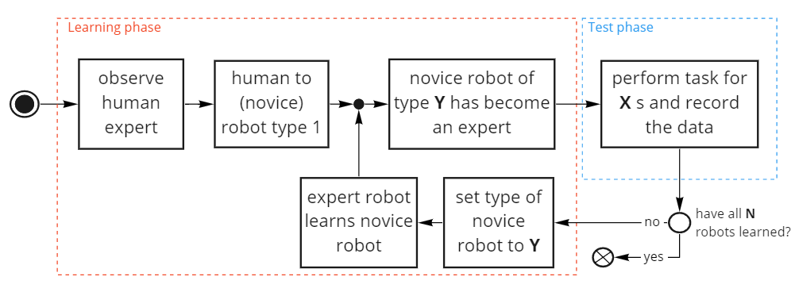
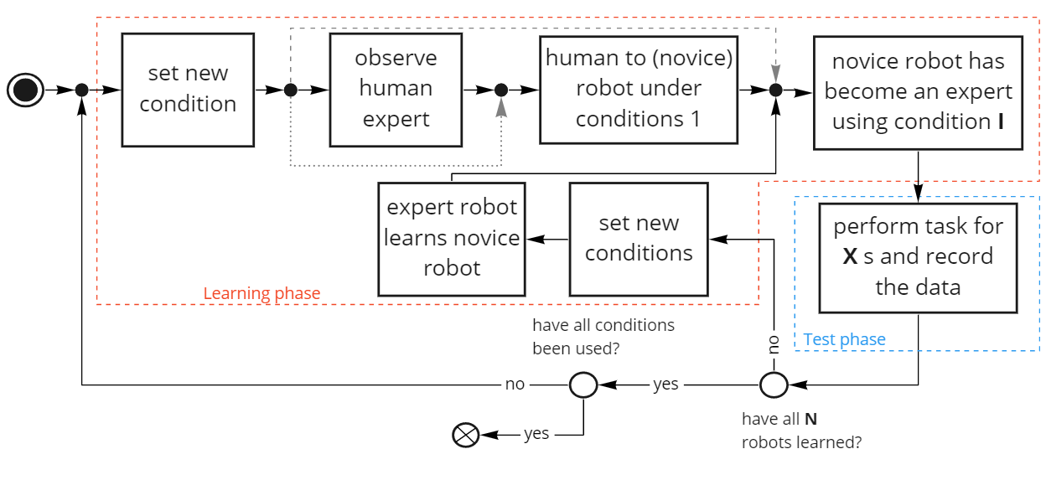
Experiment 2
Multiple conditions
Types of robot (Kuka 7, Kuka 14, Panda)
Material
Frequency of sawing
Different demonstrations (e.g. multiple persons)
Different learning times
Learning types

Slide 6
Experiment 3
Repeat experiment 1 multiple times, try to have the same conditions in each experiment:
Human Demonstration
Starting position
Same parameters

Slide 7

Metrices to examine the mutation
Fourier series
Minimum jerk model $C= \int_{0}^{T}{\overset{⃛}{x dt}}$
Overlay between signal (only possible if there is not phase shift)
Amplitude of signal
For stiffness maximum might also be useful as amplitude is often much smaller (does not reach 0)
Peaks

Slide 8
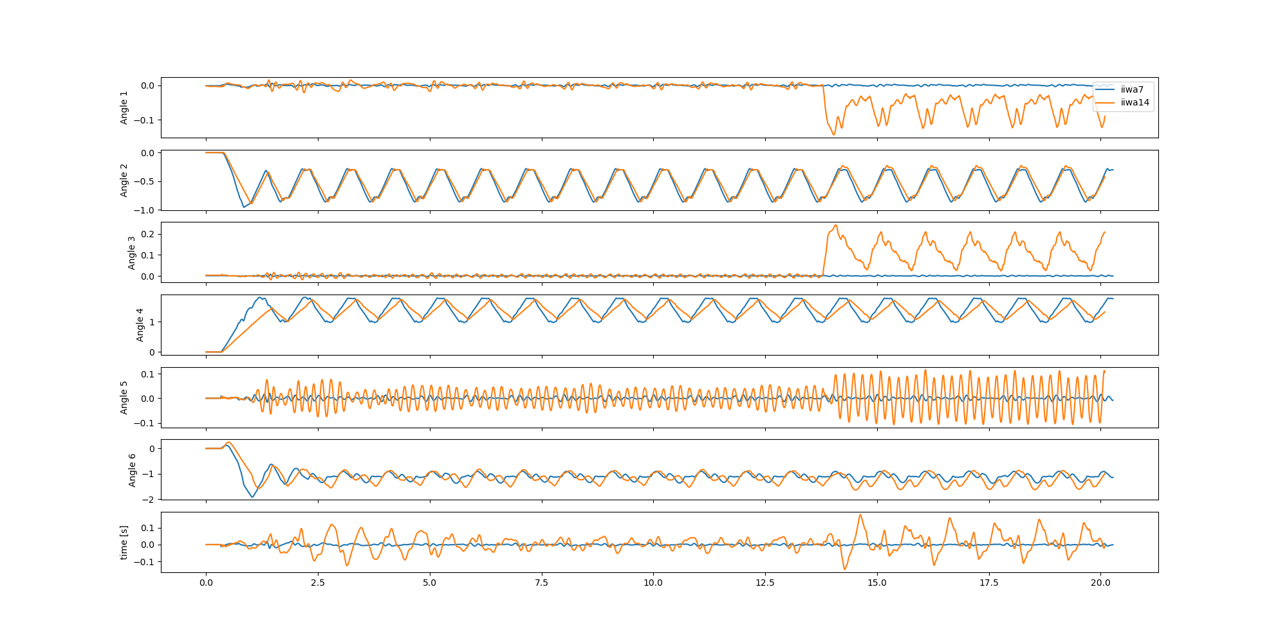
ROS Simulation

Slide 9
Next steps
Sit with Leandro
Adjust Gazebo environment to have robots holding a saw
Here for initial configuration needs to be adjusted
Implement 3-layer learning scheme (partially done, but makes no sense until saw is added)
Finish the support of the hypotheses

